Slide 1


FYP - II
Online Auction App
Bismah Imran 1797-2021
M.Umair Khan 491-2021
Maham Mirza 1922-2021
Supervisor:
Osama Ahmed Khan
Department of Computing, FEST
Hamdard University

Slide 2
Summary
Problem Statement
Objective
FYP Scope
Our methodology
Our Project Plan (Time lines)
Budget / Costing (if any)
FYP Deliverables
Literature Review
Demo of 100% of Work
Experimental Evaluations & Results
Test Plan & Test Cases
References

Slide 3
Problem Statement
Current e-commerce platforms limit interactions with fixed pricing, reducing opportunities for buyers and sellers. The Online Auction App transforms this by offering a dynamic, real-time bidding system, enhancing engagement and maximizing value for both parties

Slide 4
Objective
The objective of this project is to develop a real-time Online Auction App that enhances traditional e-commerce experiences by introducing dynamic bidding, secure communication, and seamless user interaction. The app aims to provide a scalable, mobile-optimized platform that enables users to register, post items, participate in auctions, and communicate directly through built-in chat, all while ensuring data security and real-time responsiveness through Firebase integration.

Slide 5
FYP Scope
The Online Auction App is designed to create a modern, interactive platform for buying and selling items through real time bidding. It allows users to register, create profiles, and post items for auction while providing a secure and user friendly environment. Buyers can browse auctions, place bids, and receive instant updates about their bid status. Sellers benefit from reaching a wider audience and maximizing profits through competitive bidding.
The app includes built-in chat features, enabling buyers and sellers to communicate directly, making negotiations and transactions smoother. It is optimized for mobile devices, ensuring that users can participate in auctions anytime and anywhere. Additionally, the app incorporates strong security measures to protect user data and transactions, such as encrypted communication and secure login processes. Powered by Firebase, the app ensures real-time updates and scalability, allowing it to handle a growing number of users and auctions seamlessly.
The scope of this project focuses on delivering a reliable, accessible, and engaging online auction experience, bridging the gaps in traditional e-commerce platforms and empowering both buyers and sellers with innovative tools and features.

Slide 6
Our Methodology
The Agile methodology, specifically the Scrum framework is an appropriate software development methodology for the video sentiment analysis system.
WHY?
We adopted Agile because is well-suited for projects that require flexibility, iterative development, and continuous feedback. The team can divide the work into smaller, manageable tasks and prioritize them based on their importance and value. As the project scope involves multiple components, including data collection, preprocessing, model development, real-time analysis, user interface, testing, and deployment, where some parts of system can be developed in parallel.

Slide 7
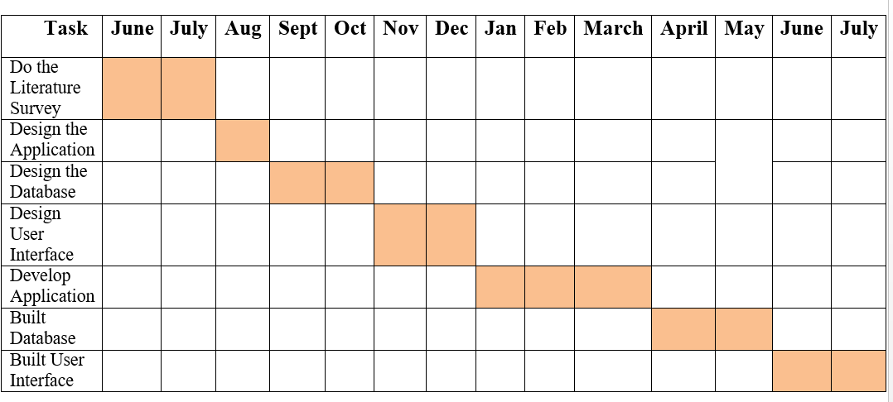
Our Project Plan

Slide 8
Budget / Costing
Estimated budget of project major resources
Developers (3 @ 700 x 4days x 4 week = 33600 x 12 = PKR 403,200 est.)
Hard Drive (Rs. 14,000 x 2 = PKR 28,000 est.)
- Laptop (Rs. 150,000 x 3 = PKR 450,000 est.)
Electricity (Rs. 5000 x 12 = PKR 60,000 est.)
- Internet (3000 x 12 = PKR 36,000 est.)
LaserJet Printer 16,000.
Miscellaneous PKR 10,000 est.
Total cost PKR 1,118,200 est.
*Detailed budget sheet will be provide.

Slide 9
FYP Deliverables
FYP-I Evaluation
FYP-II Evaluation
SRS Document
SDS Document
Project Plan Design Mockup
Project Report - I
Literature Review (First Draft)
UI Design
Proposed System
AI Chat Bot
Data Collection Interface User Manual Source Code CD Project Report - II

Slide 10
Literature/Product/Service Review
The Online Auction App seeks to innovate the traditional auction process by leveraging modern technology to enhance user experience, security, and engagement. Below is a review of related literature, existing products, and services in the field.
1. Literature Review
Evolution of Online Auctions: Research has shown that online auction platforms, such as eBay, have significantly transformed traditional auctions by allowing global participation. Studies emphasize the importance of user experience and real-time bidding as key factors in user satisfaction.
User Engagement: Literature highlights the role of gamification and real-time notifications in keeping users engaged. Features like bidding updates and personalized messages can improve user retention and activity.
Security Concerns: Numerous studies have focused on the critical need for secure transactions and data protection in online platforms. Strong authentication, encryption, and fraud detection mechanisms are crucial for maintaining user trust.
2. Product Review
eBay: One of the pioneers in online auctions, eBay offers a vast marketplace with auction and fixed-price options. Its strengths include a wide user base and advanced bidding features, but it can be complex for new users.

Slide 11
Literature/Product/Service Review
Amazon Auctions: This platform provides auction services but lacks the comprehensive auction-specific features found in dedicated auction platforms. Its integration with Amazon's vast marketplace is a significant advantage.
BidSpotter: Specializing in industrial auctions, BidSpotter offers live auction streaming and bidding. Its niche focus is its strength, though it may not cater to general consumer needs.
3. Service Review
Mobile Auction Apps: Many platforms now offer mobile apps to facilitate on-the-go bidding. These apps are often praised for their convenience but can suffer from performance issues if not well-optimized.
Real-time Notifications and Chat: Services that provide real-time updates and communication between buyers and sellers have been well-received. They enhance transparency and user satisfaction by facilitating direct negotiations and timely updates.

Slide 12
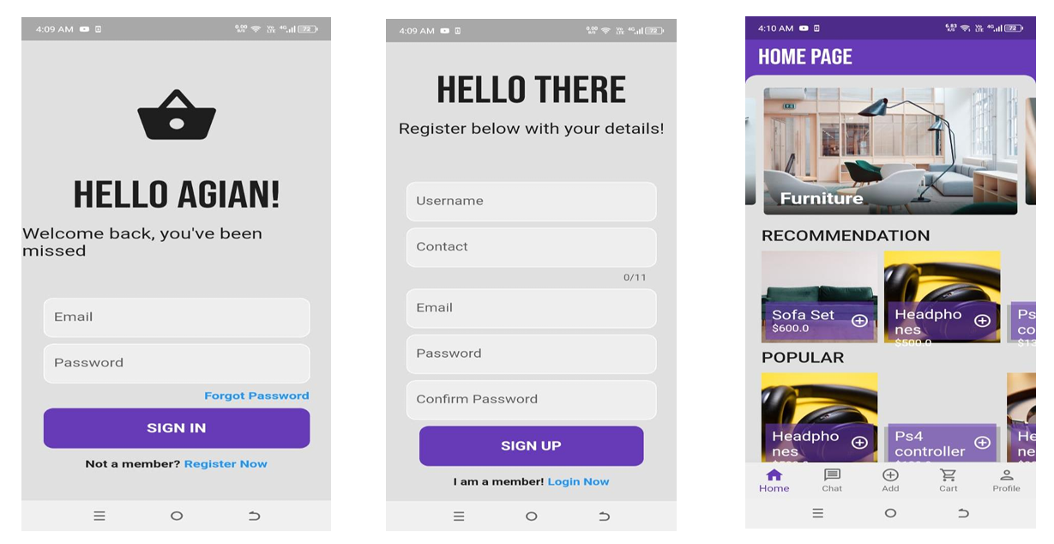
Demo of 100% of Work

Slide 13
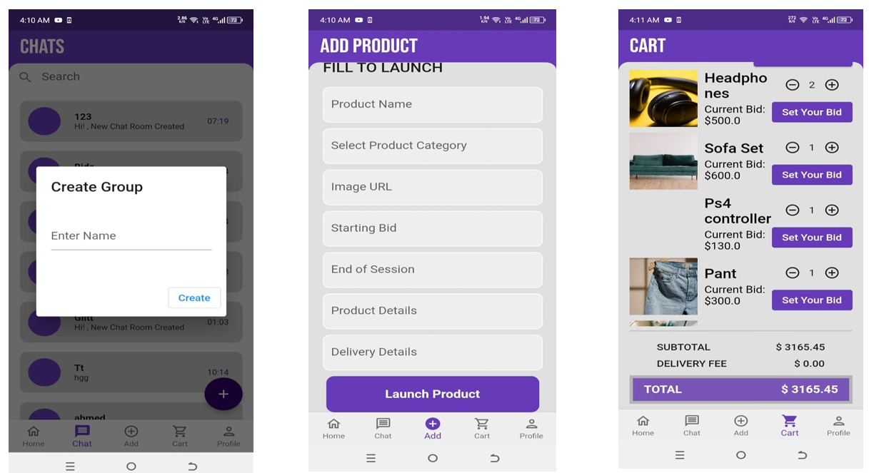
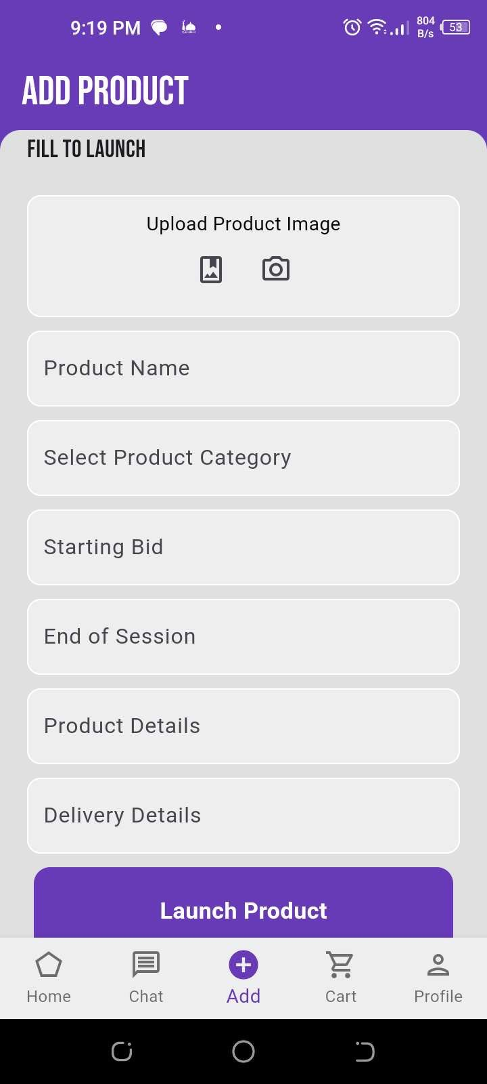
Demo of 100% of Work

Slide 14
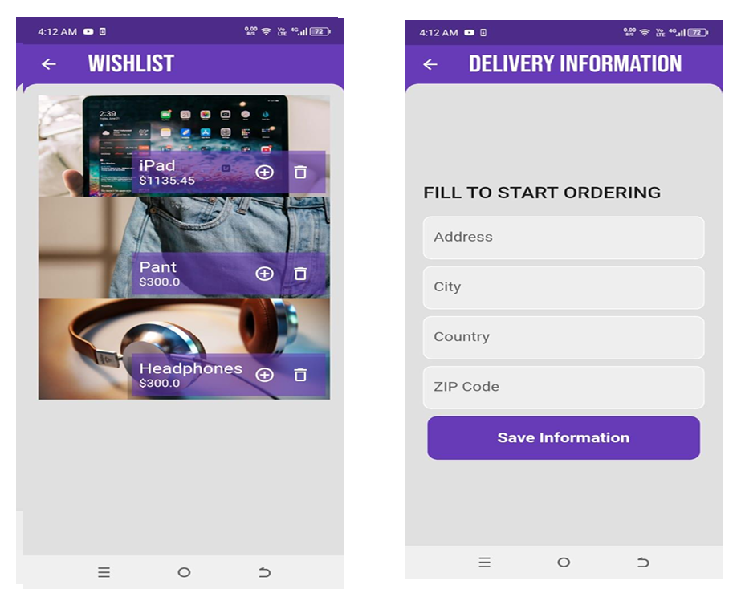
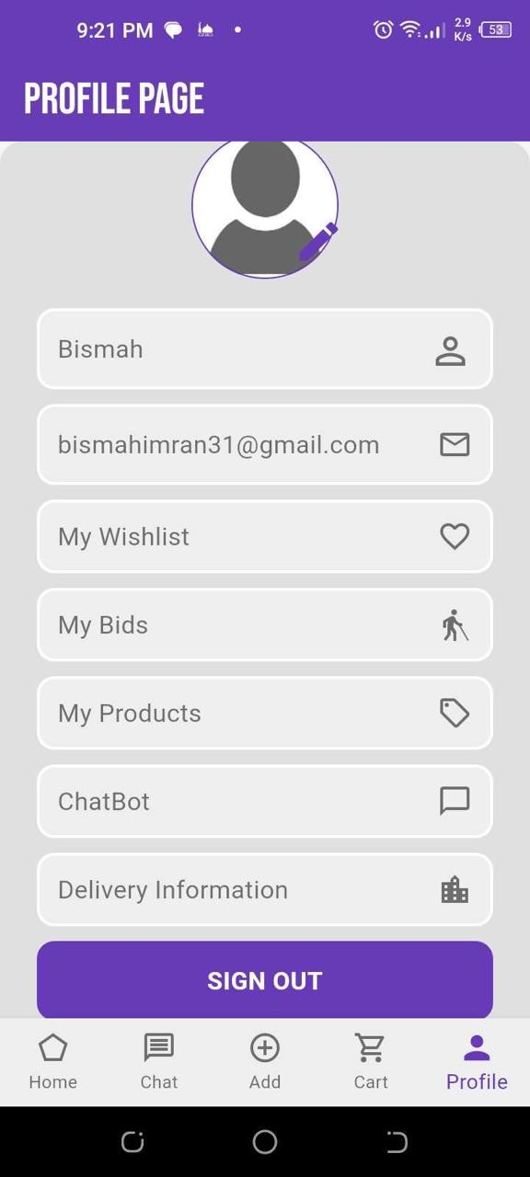
Demo of 100% of Work

Slide 15
Experimental Evaluations & Results
To assess the effectiveness, performance, and usability of the Online Auction App in providing a real-time, user-friendly auctioning experience that improves buyer-seller interaction and maximizes value through competitive bidding.
Platform: Web-based app developed using Flutter
Firbase for real time data storage
Test Users: 10 participants (5 sellers, 5 buyers).
Devices Used: Desktop, and Mobile.
Testing Duration: 2weeks.
Scenarios:
Posting an auction item
Placing real-time bids
Winning an auction
Viewing item analytics
AI Chat

Slide 16
Test Plan & Test Cases
TestCase | Description | ExpectedResult | Actual Result | Status
Loginwithvalid credentials | Userenterscorrect email & password | Userlogsin successfully | Worksas expected | Pass
Loginwithwrong password | Userentersincorrect password | Showerror message | Showserror message | Pass
Addnewauction item | Sellerfillsformand uploads image | Itemislisted successfully | Workscorrectly | Pass
Placeabid | Userplacesahigherbid than current | Bidisacceptedand updated | Bidupdatesin real-time | Pass
Notificationon new bid | Newbidisplacedon item | Notifysellerand other bidders | Notifications received | Pass
Startchatwith seller | Buyerclicksonchat button | Chatopenswith correct user | Chatfunctions properly | Pass

Slide 17
Reference
D. Gupta, How to Build an Online Auction Application.Benefits, Features, Costs, 2024.
G. Patil, Online Auction App Development: A Complete Guide, India (Delhi), 2022.
J. Tiwary, Auction App Development: Unlocking the Future of Online Bidding, India (Mumbai), 30 October, 2023.
M. Butt, How to Create an Online Real-Time Bidding/Auction App, Mumbai (bendra), 2022.
Ajay, How to Develop an Application for Online Auctions? Features, Advantages, and Costs, Chennai, 2024.

Slide 18
THANK YOU!

